Slide 1

Self Adjusting Contention Friendly Concurrent Binary Search Tree by Lazy Splaying
Cameron White, Jack Branch, Bradford Stephens

Slide 2
Why?
Problem
Solution
advancement of multi-core computers and disappearance of unicore computers, multi-threaded programs are not just an option but the necessity of this period
Sequential data structures are not consistent in a multi-threaded because threads may execute asynchronously
Concurrent data structures allow concurrent threads to store, organize, and access the data on a shared memory system however, it's extremely difficult to design concurrent data structures compared to sequential ones because threads executing concurrently may interleave their steps in many ways resulting in different and potentially unexpected outcomes

Slide 3
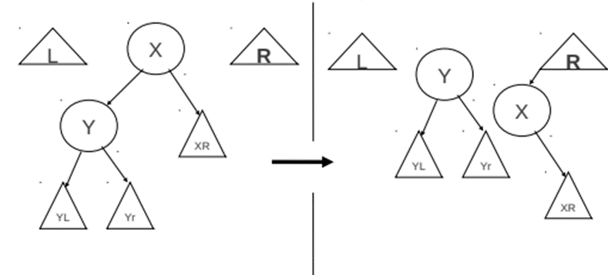
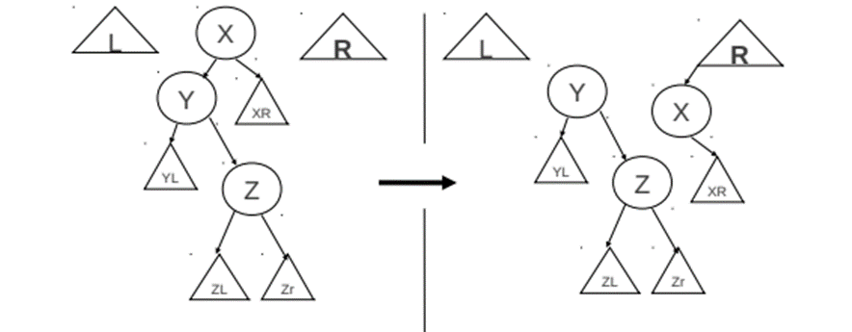
How does this compare to Splay Binary Search Trees?
Zig
The operations we perform in this technique are called zig-zag or zig operations as in regular splay tree. Unlike regular splay tree, splaying operations that involve other rotations like zig-zig, we perform only two operations zig-zag or zig. Only performed if certain conditions are met at particular accessed node. The top-down version of these operations are used because it does not need traversal from the root
Uses Semi Splaying technique to modify the restructuring rule of Splaying so that it rotates only some of the edges along an access path, thus moving the accessed node only partway toward the root.
Zig-Zag

Slide 4
Lazy splaying
We use a technique called lazy splaying that can frequently move accessed items close to the root of the tree without forcing the root to bottleneck. Through this, the more frequently accessed items will appear near the root of the tree and the less frequently accessed items stay near the bottom of the tree
In addition to the above task, this operation has one extra responsibility of deleting the nodes that were lazily deleted during delete operation if it is safe to do so and if the removal of node generates less contention. nodes that are lazily deleted and have at least one of their children as empty subtree are removed.
re-structuring of the tree creates the excessive contention, separating this process from abstract modification produces less contention during concurrency and the lazy splaying resolves the standard splaying root-bottleneck, making this technique efficient, scalable and highly concurrent BST.
counting the total no. of operations in different parts of the tree can be done asynchronously without using lock. This may create a synchronization issue on these counters but is tolerated as the inaccuracies in these counters will have negligible effect on the performance (reference 7). So, this eliminates the extra locking operations necessary to synchronize counters and improves performance significantly

Slide 5

Eager Abstract Modification/Lazy Structural Adaptation
In most of the existing self-adjusting binary search tree, once the structure gets updated the structure is checked if it satisfies its height property however, the update operation effects only the smaller portion of tree this restructuring may affect globally and potentially conflicts with other concurrent updates resulting higher contentions
So those operations are split and handled by a dedicated thread, the techniques are used by the this thread are called lazy
Main advantage of postponing the re-structuring operation is to enable merging of multiple adaptation in one simplified step. Reduces the contentions produced by abstract modifications.

